Slide 1
Our SuperChat
Khanh, Tyler, Grant, and Caleb

Slide 2
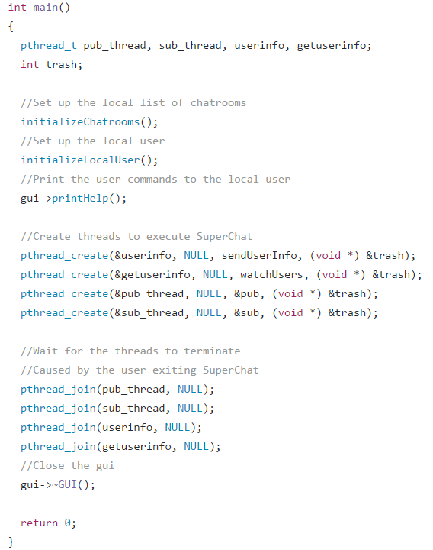
General Code Functionality
Thread structure
Chatroom Integration
User Integration
SLOC

Slide 3
OpenSplice Utilization
Communication between instances
Writers
Publishers
Entity Manager
Topics
Subscribers
Readers
DDS Manager
Topics
Participants

Slide 4
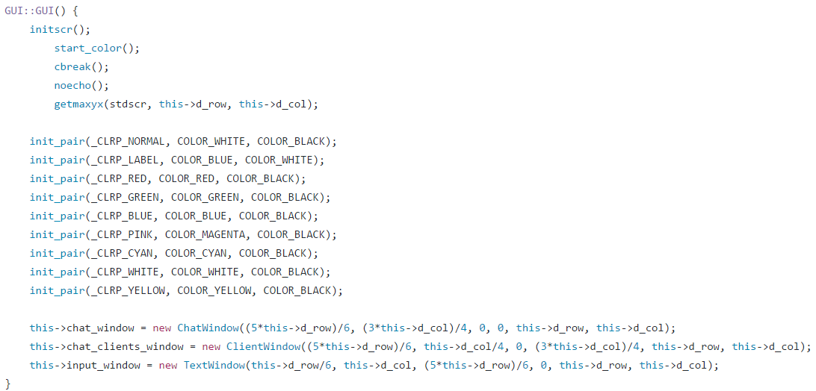
N-Curses Integration
Initialization of GUI
GUI Structure
Chatrooms
Users
Commands

Slide 5
Performance Thus Far
Capabilties
Any Missing Features
User Description Integration
Bugs
Current Bugs
Past Bugs (fixed)

